Slide 1
Common Problems and Solutions Bagfilter problems
Solutions/Plant Measures

Slide 2
Solutions/Plant Measures
Target
Bring back dust emissions below 20mg/Nm3, decrease Δp below 15mbar, reduce corrosion problems and increase lifetime of bags >3 years
Measures to increase lifetime of bags
Replace bags by a better quality, e.g. glass fiber PTFE-membrane
Reduce Cl in the outer cycle by creating dust extraction in direct operation
Avoid running below the acid dew point (increase T and or reduce SO2 in direct operation)
Stop using sludge in the raw mill in order to avoid VOC
Reinstall bags in a proper way in order to avoid that they touch each other
Adapt cages and bags (e.g. cages 159mm, bags 160mm)
Apply a pre-coating of the bags with raw meal
Notes:
- Glassfaserschläuche sind sensibel auf hohe A/C

Slide 3
Solutions/Plant Measures
Measures to decrease pressure drop over bags
Clean according to pressure profile
Extract dust as a Cl valve and stop using sludge in the raw mill
Adjust blow pipes arrangement
Repair cleaning air leakage/modify design of cleaning air system (compressors, valves, pipes, etc.) and install an air drier – has to be replaced by a low pressure system (cf. below)
Decrease A/C by:
Repairing magnetic valves so that entire 1512 bags are properly working
Increasing the length of the bags from 4 to 7.5 m
Install a low pressure cleaning system for 7.5 m long bags
Notes:
- Reduce pressure drop by limiting VOC and dew point

Slide 4
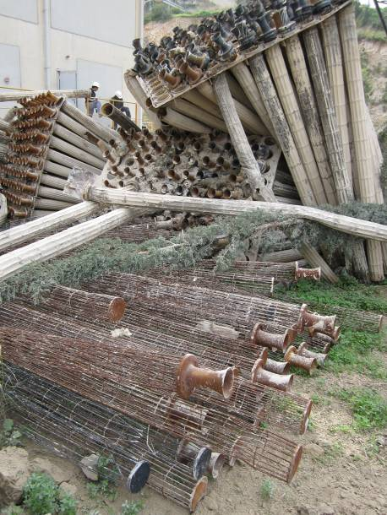
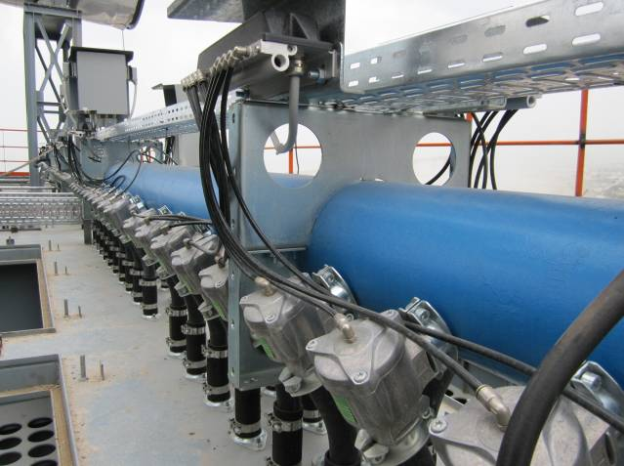
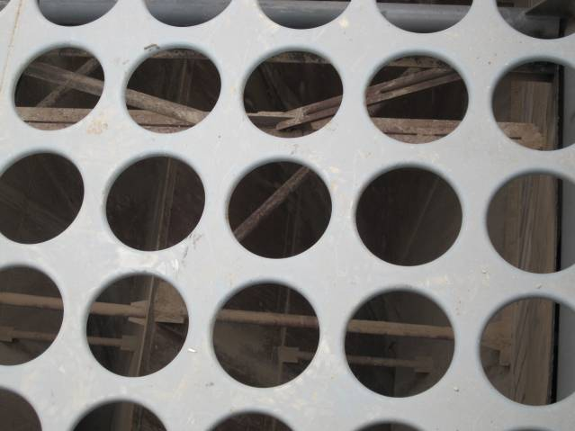
Replacement of the tube sheet and cleaning system

Slide 5
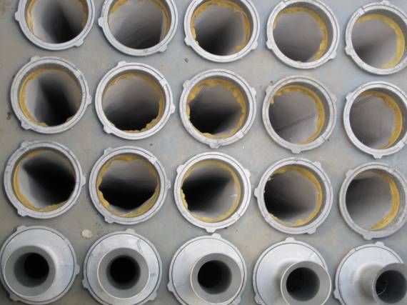
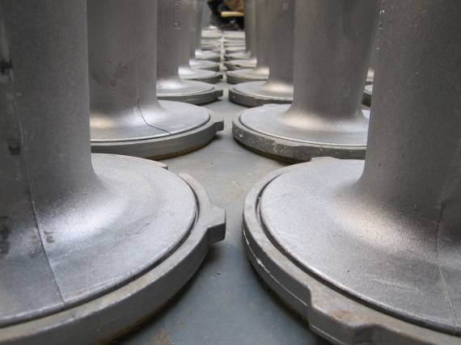
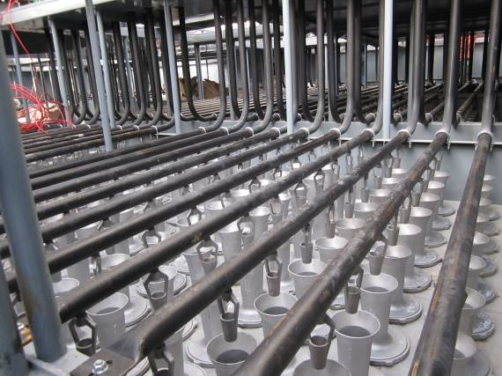
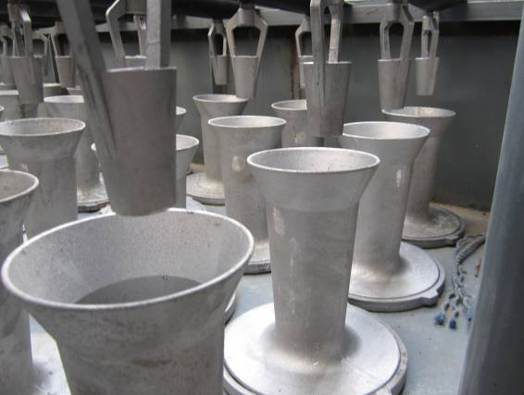
Replacement of the tube sheet and cleaning system

Slide 6
Solutions/Plant Measures
Decrease can velocity by installing baffle plates at the inlet of the compartments:
60% of the gases are introduced from the bottom to the bags
40% of the gases are introduced from the side to the bags
Can velocity decreases from 2.1 to 1.3 m/s
Measures to avoid corrosion problems:
Apply a protective coating, e.g. FlueGard 225, Inertol, Flamecontrol 500, ...
Increase filter temperature to 200°C in direct operation (also reduces moisture) and to 125°C in compound operation
Create Cl valve
Notes:
A/C problem solved by increasing bag length
Can velocity solved by introducing gases laterally and from below (baffle plates)
New can velocity calculated assuming higher filter inlet temperature

Slide 7
Solutions/Plant Measures
Summary new A/C:
Increase Temperature in compound (125°C) and direct operation (200°C)
Increase number of working bags from 1’484 to 1’512 bags
Increase bag length from 4 to 7.5 m
New A/C : < 1.0 m/min

